Slide 1
BIG-BRAIN ADVERTISING.
MAS Mandate 2 | Vijay Jaisankar

Slide 2
01
02
REVIEW
ADVERTISEMENTS
03
04
NEUROMARKETING
WHERE RCT FAILS
Of classic rational choice theory
And why we hate them
Wait, what?
WhO cOuLd hAvE sEeN tHiS cOmInG?

Slide 3
INTENT OF THIS MANDATE
To correlate some of the topics covered in class with common marketing concepts; and to showcase something cool!

Slide 4
RATIONAL CHOICE THEORY
Choose an action based on a set of preferences that maximises expected utility (payoff ⬆️ and cost ⬇️)

Slide 5
What would you choose?
Choose wisely, live well ™️

Slide 6
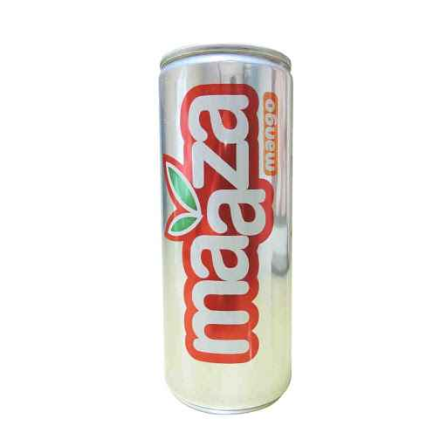

300ml for Rs 50
200ml for Rs 30

Slide 7

300ml for Rs 50
200ml for Rs 30

Slide 8

300ml for Rs 50
600ml for Rs 60
200ml for Rs 30

Slide 9
HOW ADVERTISERS CAN USE CONSUMERS’ RATIONALITY
ASSIST
DISCOVER
MODIFY
Consumers in making rational calculations through value communication
Spending habits by modelling consumers as rational agents
The consumers’ valuations through market manipulation

Slide 10
HOW FAR CAN THEY TAKE THIS?
Read: What is misleading advertising?

Slide 11
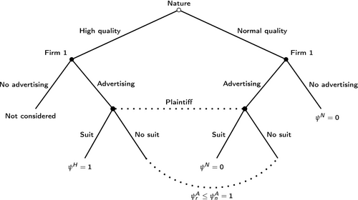
Effects of false advertising on posterior beliefs

Slide 12
Why do companies defer from false advertising?
Knowledge and intelligence of the consumer
Cost of developing a reputation for dishonesty
Competition among firms resulting in rival firms dunking each other
Private legal actions by consumers

Slide 13
DOES SOMETHING
Seem wrong?

Slide 14

Have you seen this meme?

Slide 15
Neuromarketing
The measurement of physiological and neural signals to gain insight into customers’ motivations, preferences, and decisions, which can help inform creative advertising, product development, pricing, and other marketing areas. [Harvard Business Review]
Companies find out more about customers by finding out what drives them to prefer and buy things.

Slide 16
Neuromarketing is …
どこにでも
Повсюду
ทุกที่
So many disciplines, so many modalities.

Slide 17
Some strategies
Divert attention
Appeal to all 5 senses
Distributed architecture

Slide 18

A Picture Is Worth a Thousand Words

Slide 19
A Prop Is Worth a Thousand More

Slide 20
Let’s talk about coke.
No, not that coke.

Slide 21
The manifestation of neuromarketing
Red and white branding - Visual
Taste has remained the same*
Smell of the product highlighted in advertisements
Touch - shape of the product consistent over the years
Sound - recall every single soft drink ad :)

Slide 22
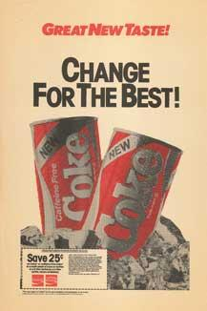
Brands are much more than the products they make.
“The fabled secret formula for Coca-Cola was changed, adopting a formula preferred in taste tests of nearly 200,000 consumers. What these tests didn't show, of course, was the bond consumers felt with their Coca-Cola — something they didn't want anyone, including The Coca-Cola Company, tampering with.”

Slide 23
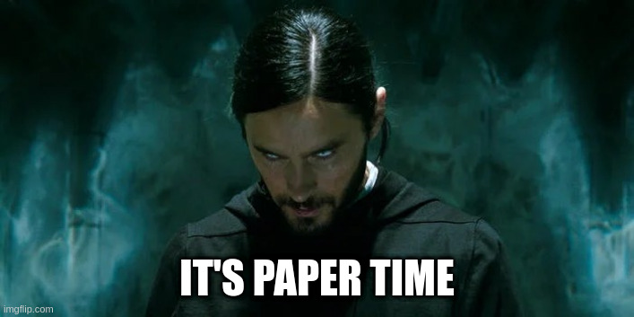
Analysis of EEG signals and its application to neuromarketing - Yadava et al.

Slide 24
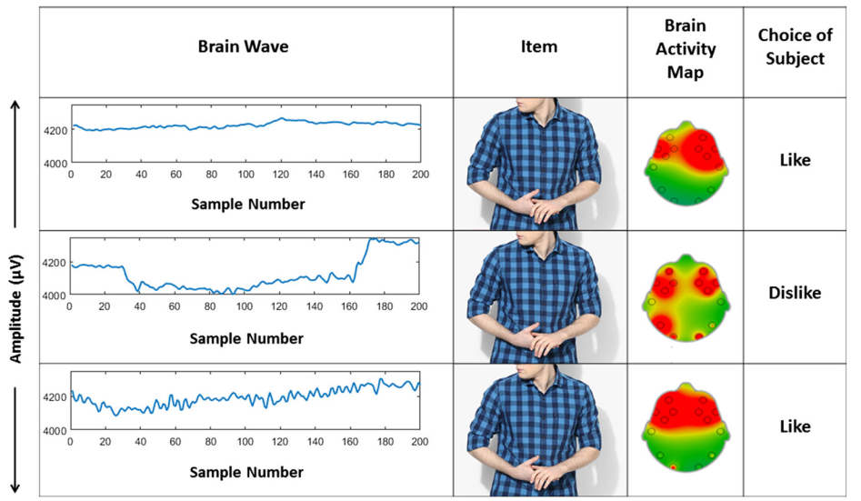
EEG Analysis

Slide 25
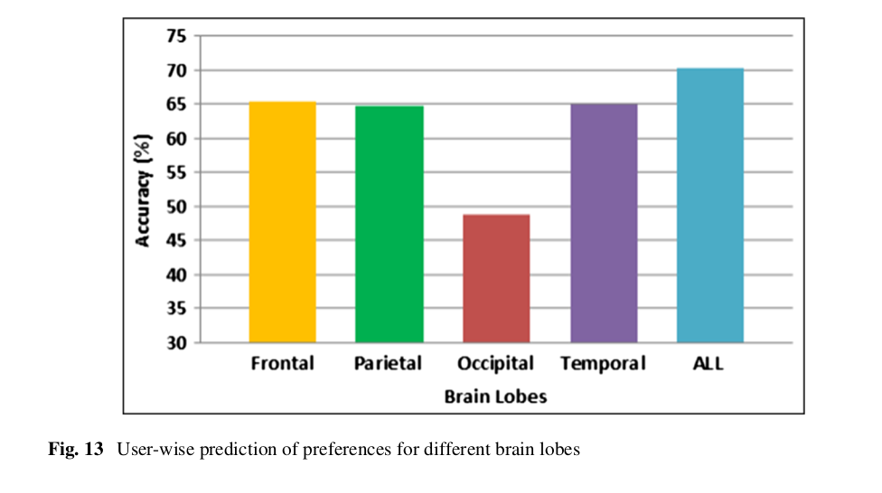
Selective analysis

Slide 26
Why people dislike advertisements
“Chances are you’re either creeped out and annoyed by the ad or pleased to be reminded to go back and buy those beautiful boots. If we had to venture to guess, we’d say most folks fall into that first bucket.”
More generally, 91% of respondents agree ads are more intrusive today compared to two to three years ago, and 87% agree there are more ads in general. 79% also feel that they’re being tracked as a result of retargeted ads. [Hubspot research]

Slide 27
What is your least favorite ad, and why?

Slide 28
Critiques of RCT
Bounded Rationality
Satisficing
Cognitive dissonance
Sticking mechanism for the consumer
Prospect theory
Hashmaps in the face of risk

Slide 29
Moral of the story
We are being gamed. Nice.

Slide 30
RESOURCES
Coca-cola’s use of Neuromarketing - https://tandem.buzz/neuromarketing/coca-colas-neuromarketing-strategy-sensory-marketing/
“New coke” debacle - https://www.coca-colacompany.com/company/history/new-coke-the-most-memorable-marketing-blunder-ever
Introduction to Neuromarketing - https://www.youtube.com/watch?v=sVpSr5xJiNw
Summary of neuromarketing - https://hbr.org/2019/01/neuromarketing-what-you-need-to-know
Neuromarketing paper - https://link.springer.com/article/10.1007/s11042-017-4580-6
Rational choice theory and marketing budgets - https://www.economicsonline.co.uk/behavioural_economics/rationalchoicetheoryandmarketingbudgets.html/
MAS slides - https://drive.google.com/file/d/1Xx8W2iKCDkJddiQnIOEze_1YxXd7e4Tq/view
Deceptive advertising and critique of RCT - https://ideas.repec.org/a/eee/pubeco/v51y1993i3p359-378.html
Modelling deceptive advertising - https://onlinelibrary.wiley.com/doi/10.1111/caje.12457
More about critiques of RCT - https://compass.onlinelibrary.wiley.com/doi/full/10.1111/phc3.12774
Why people dislike ads - https://wistia.com/learn/marketing/the-psychology-behind-why-people-dislike-ads
Hubspot survey - https://blog.hubspot.com/marketing/why-people-block-ads-and-what-it-means-for-marketers-and-advertisers?__hstc=77521994.cbf362f42afcd3c9d980eb2154865fb0.1680726933583.1680726933583.1680759748427.2&__hssc=77521994.1.1680759748427&__hsfp=2336575099
Cognitive dissonance - https://www.medicalnewstoday.com/articles/326738
Prospect theory - https://www.investopedia.com/terms/p/prospecttheory.asp

Slide 31
THANKS!
Any questions?

